Slide 1
Clustering: K-means and Hierarchical Clustering
Machine Learning

Slide 2
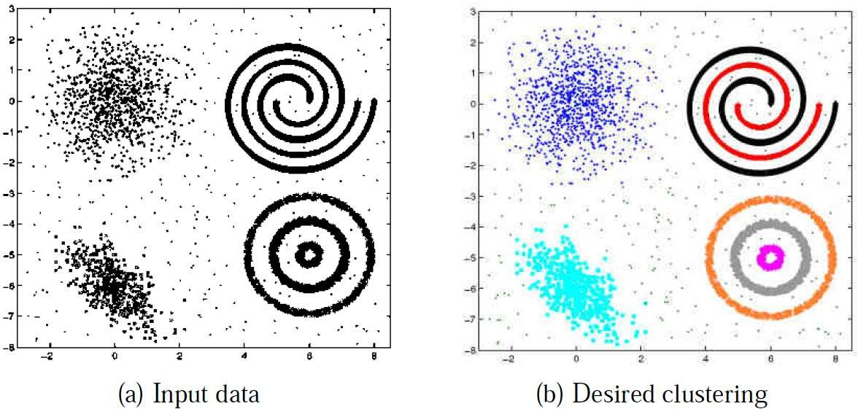
Clustering
Unsupervised learning problem
Given: N unlabeled examples {x₁, . . . , x_{N} }; the number of partitions K
Goal: Group the examples into K partitions
The only information clustering uses is the similarity between examples
A good clustering is one that achieves:
High within-cluster similarity
Low inter-cluster similarity

Slide 3
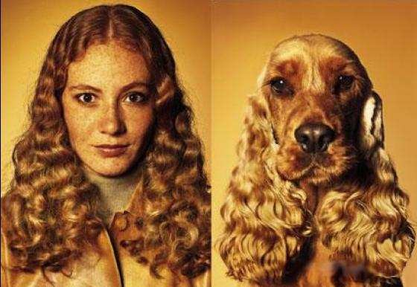
Similarity is Subjective
Similarity is often hard to define
Different similarity criteria can lead to different clusterings

Slide 4
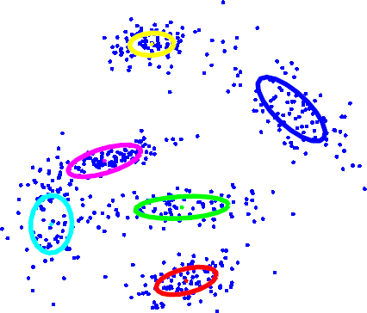
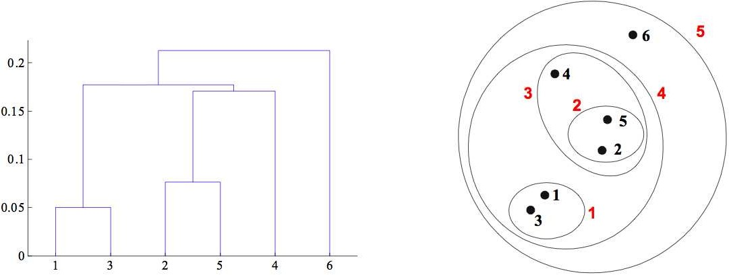
Types of Clustering
1
Flat or Partitional clustering (K -means, Gaussian mixture models, etc.)
Partitions are independent of each other
2
Hierarchical clustering (e.g., agglomerative clustering, divisive clustering)
Partitions can be visualized using a tree structure (a dendrogram) Does not need the number of clusters as input
Possible to view partitions at different levels of granularities using different K

Slide 5
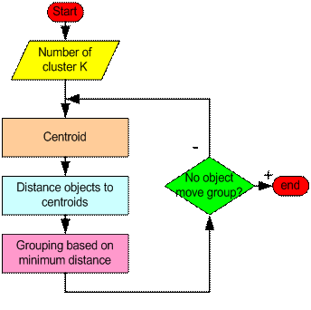
Flat Clustering: K -means algorithm (Lloyd, 1957)

Slide 6
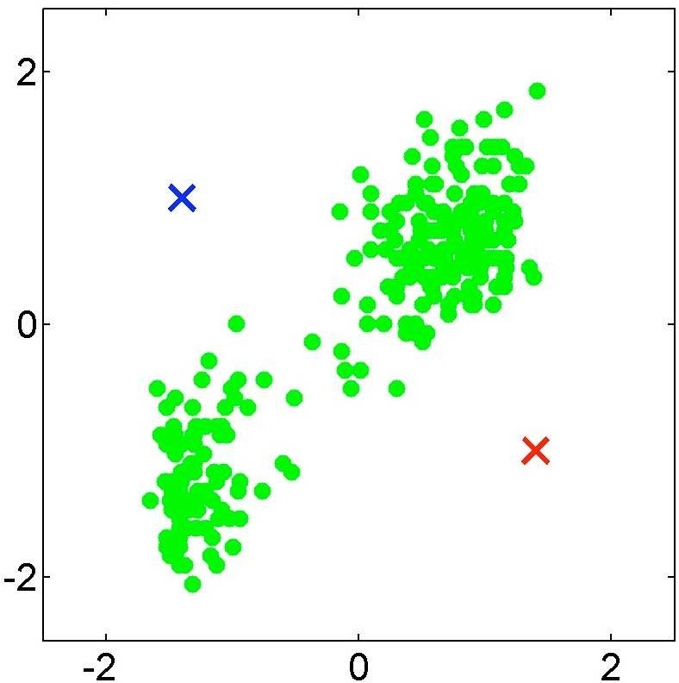
K -means: Initialization (assume K = 2)

Slide 7
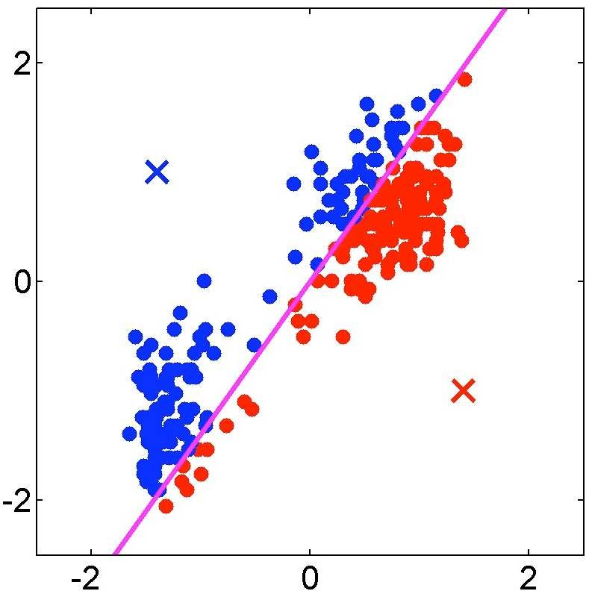
K -means iteration 1: Assigning points

Slide 8
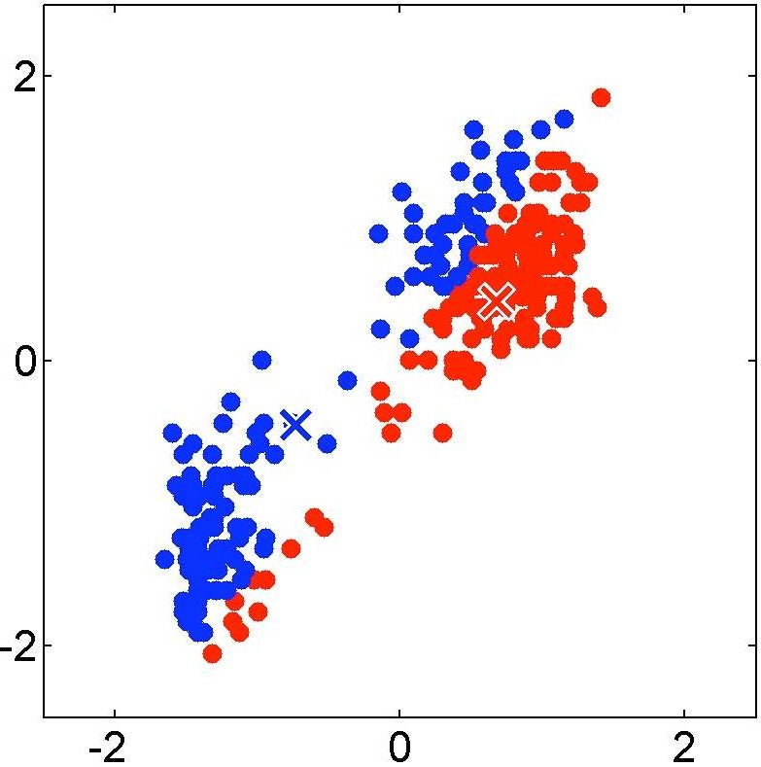
K -means iteration 1: Recomputing the cluster centers

Slide 9
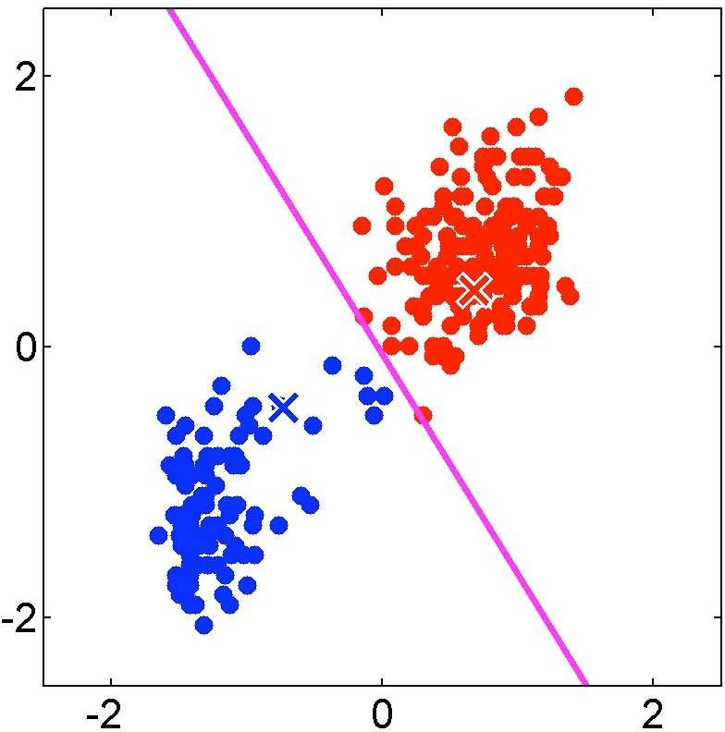
K -means iteration 2: Assigning points

Slide 10
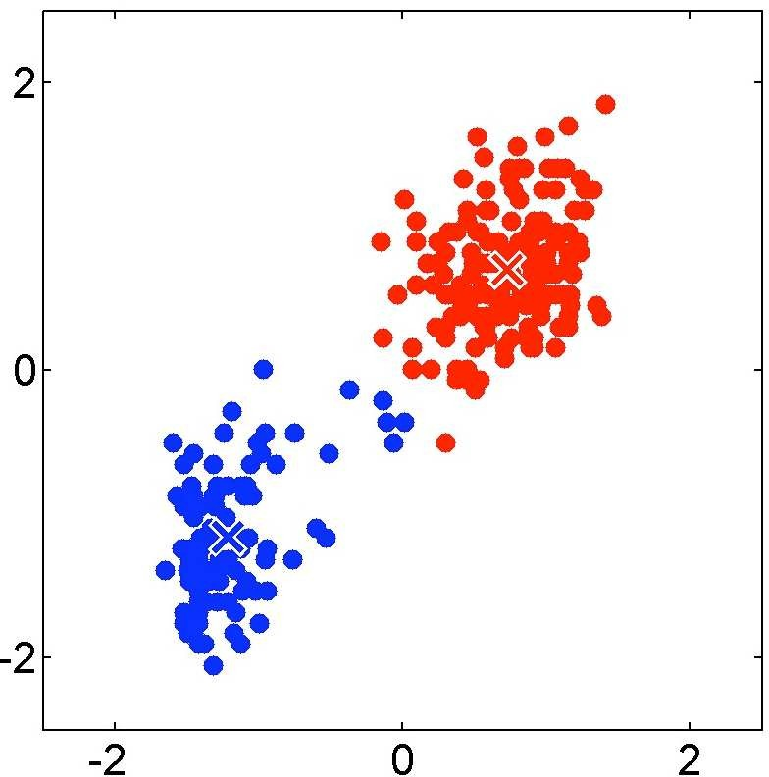
K -means iteration 2: Recomputing the cluster centers

Slide 11
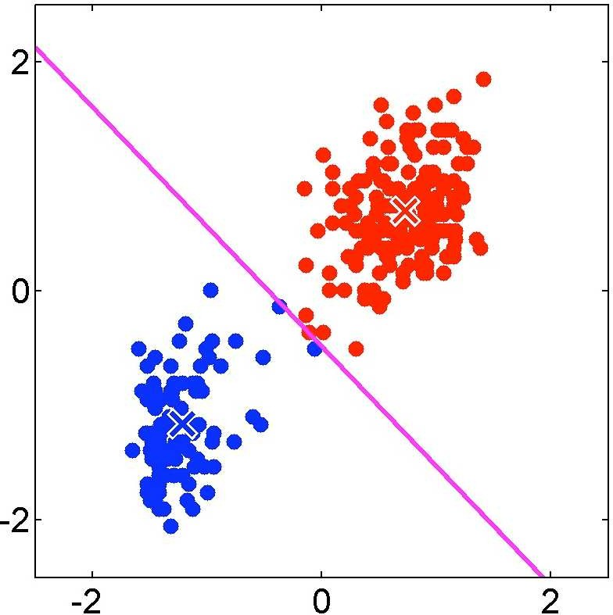
K -means iteration 3: Assigning points

Slide 12

K -means iteration 3: Recomputing the cluster centers

Slide 13
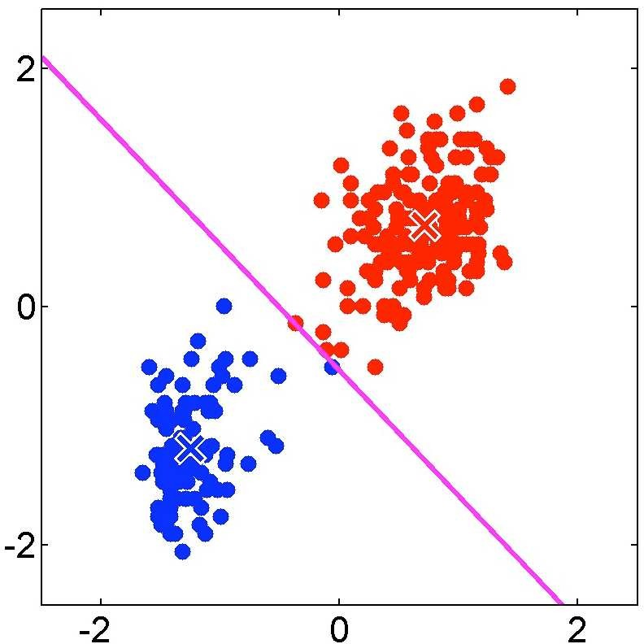
K -means iteration 4: Assigning points

Slide 14
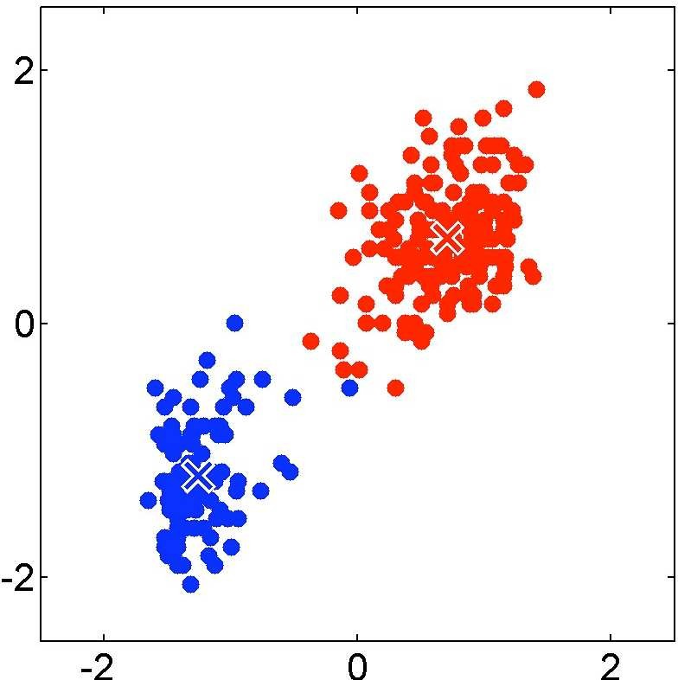
K -means iteration 4: Recomputing the cluster centers

Slide 15
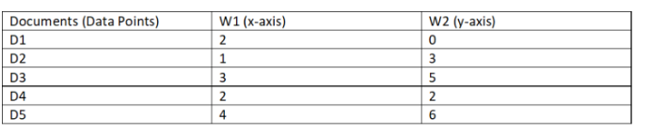
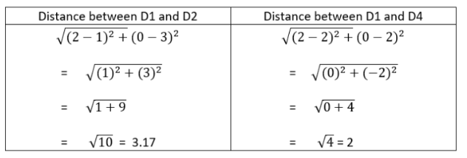
K -means iteration: Example
D2 and D4 are the centroids
Euclidean distance – sample below:

Slide 16
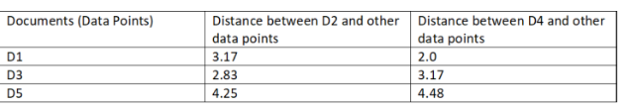

K -means iteration: Example
Cluster 1 – D2, D3, D5
Cluster 2 – D4, D1
Next step – calculate new centroid for each cluster
(2, 1) and (2.67, 4.67)

Slide 17
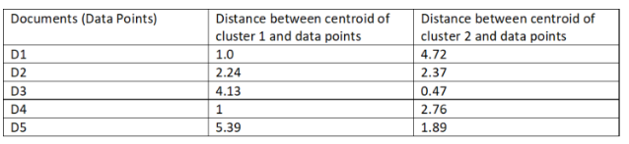
K -means iteration: Example
Previous:
Cluster 1 – D2, D3, D5
Cluster 2 – D4, D1
New:
Cluster 1 – D1, D2, D4
Cluster 2 – D3, D5
Calculate new centroids and repeat

Slide 18
K -means: Initialization issues
K -means is extremely sensitive to cluster center initialization
Bad initialization can lead to
Poor convergence speed
Bad overall clustering
Safeguarding measures:
Choose first center as one of the examples, second which is the farthest from the first, third which is the farthest from both, and so on.
Try multiple initializations and choose the best result
Other smarter initialization schemes (e.g., look at the K -means++ algorithm by Arthur and Vassilvitskii)

Slide 19
K -means: Limitations
Makes hard assignments of points to clusters
A point either completely belongs to a cluster or not at all
No notion of a soft assignment (i.e., probability of being assigned to each cluster: say K = 3 and for some point xn , p1 = 0.7, p2 = 0.2, p3 = 0.1)
Gaussian mixture models and Fuzzy K -means allow soft assignments
Sensitive to outlier examples (such examples can affect the mean by a lot) K -medians algorithm is a more robust alternative for data with outliers Reason: Median is more robust than mean in presence of outliers
Works well only for round shaped, and of roughly equal sizes/density clusters
Does badly if the clusters have non-convex shapes
Spectral clustering or kernelized K -means can be an alternative

Slide 20
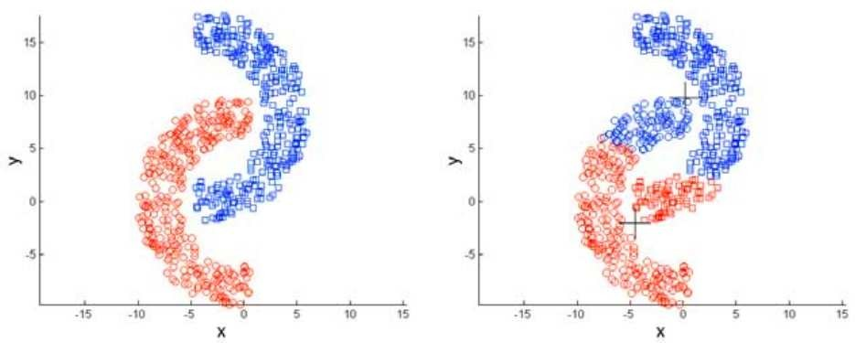
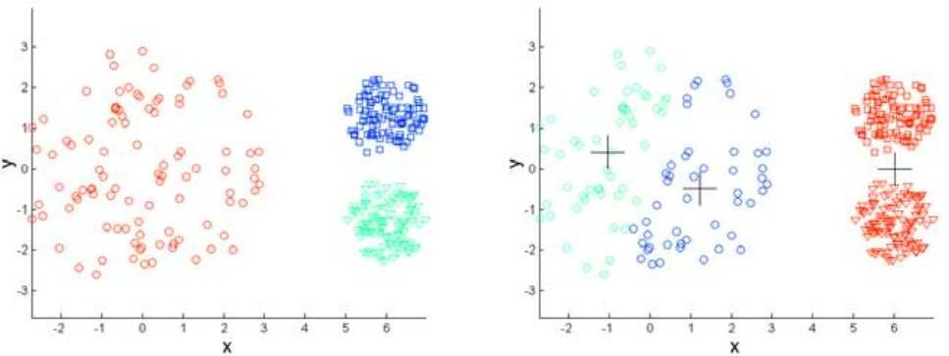
K -means Limitations Illustrated
Non-convex/non-round-shaped clusters: Standard K -means fails!
Clusters with different densities
Picture courtesy: Christof Monz (Queen Mary, Univ. of London)

Slide 21
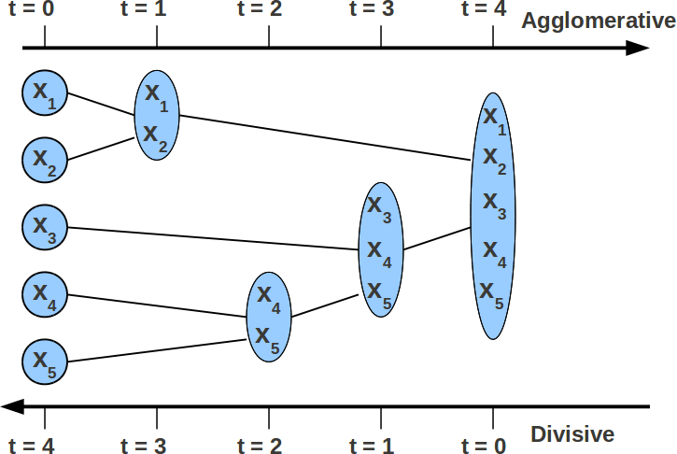
Hierarchical Clustering
Agglomerative (bottom-up) Clustering
1
Start with each example in its own singleton cluster
At each time-step, greedily merge 2 most similar clusters
Stop when there is a single cluster of all examples, else go to 2
2
3
Divisive (top-down) Clustering
1
Start with all examples in the same cluster
At each time-step, remove the “outsiders” from the least cohesive cluster Stop when each example is in its own singleton cluster, else go to 2
2
3
Agglomerative is more popular and simpler than divisive (but less accurarate)

